Slide 1
GROUP NO: 14
Here is where your presentation begins

Slide 2
-
Member’s:
SARTHAK DARANDALE
SARTHAK DARANDALE
SARTHAK JADHAV
TEJAS BHAGWAT
ADITYA JOSHI
NIRANJAN DEOKAR

Slide 3
TABLE OF CONTENTS
01
02
03
04
RECYCLING USED AND OLD THINK
Overview
Features of the Topic
Assignment
About the Topic

Slide 4
INTRODUCTION
INTRODUCTION
Recycling old and used things helps protect the environment by reducing waste and saving resources. Instead of throwing things away, we can reuse or remake them into new products. This project will we are create mobile cover and other new product, in this project we are collecting a raw materials will be recyclable
Venus has a beautiful name and is the second planet from the Sun. It’s terribly hot—even hotter than Mercury—and its atmosphere is extremely poisonous. It’s the second-brightest natural object in the night sky after the Moon

Slide 5
Persona
Of
ENDUSERS

Slide 6
END USERS
1.STUDENTS
2.SCHOOLS AND EDUCATIONAL INSTITUTIONS
3.RECYCLING CENTER
4.GOVERMENT AND MUNICPAL BODIES

Slide 7

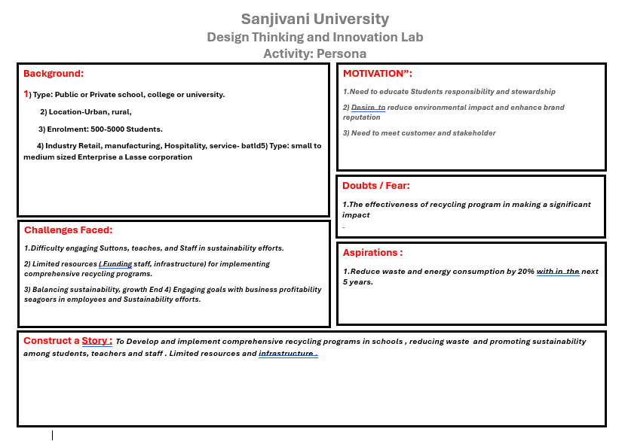
A picture is worth a
thousand words

Slide 8
MIND MAPING

Slide 9
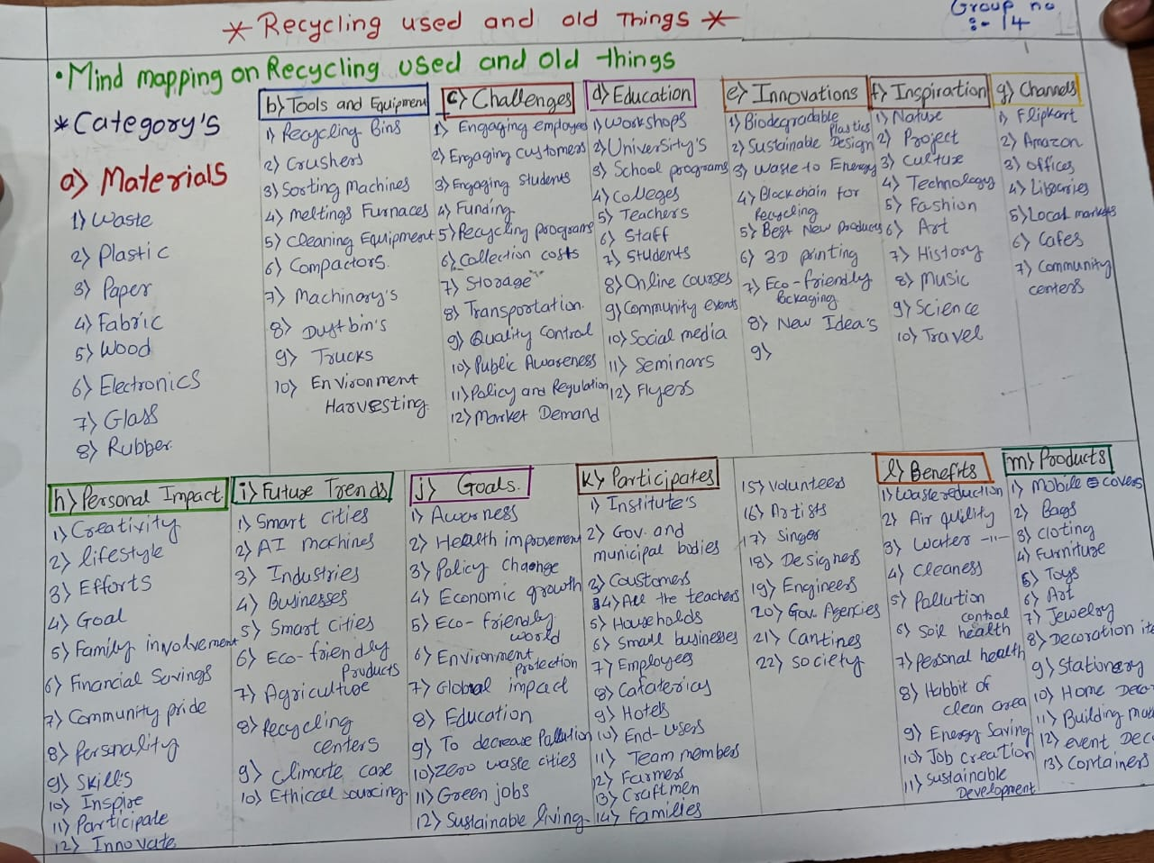

Slide 10
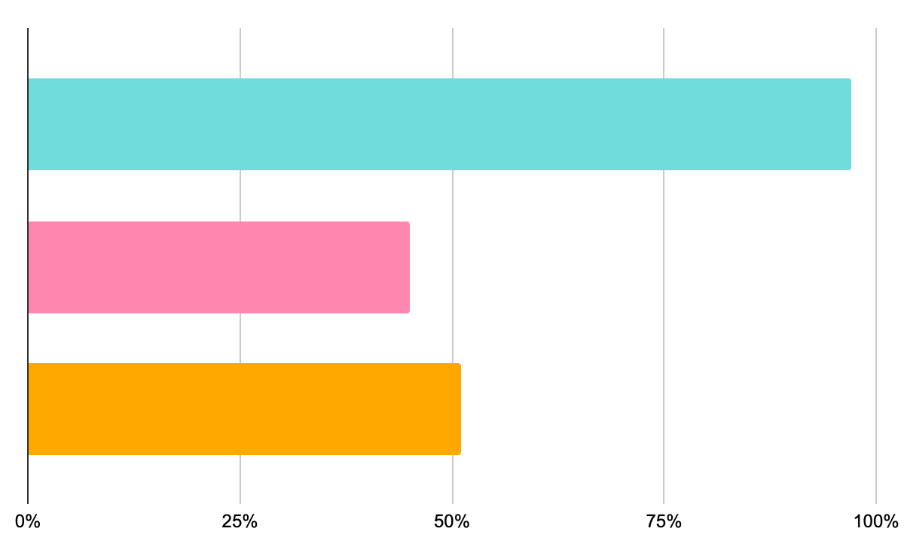
BRAINSTROMING AND IDEATION
AFTER 5YEAR MY PROJRCT WILL BE
"Aafter 5 years, we are making app will be the go-to platform for users to express themselves .
1.User-centric Design
Develop an intuitive and user-friendly interface that allows users to easily design and customize phone covers and other items.
Incorporate features that enable users to upload their own designs, images, or text.
Consider integrating AI-powered design tools to assist users in creating unique and personalized designs.
2.CUSOMIZATION OPTIONS
Offer a wide range of design templates, patterns, and colors for users to choose from.
Allow users to customize the layout, font, and style of their designs.
Consider integrating 3D visualization tools to enable users to preview their designs in real-time.
Women Safety Rank:
-
orway
I
celand
S
witzerland

Slide 11
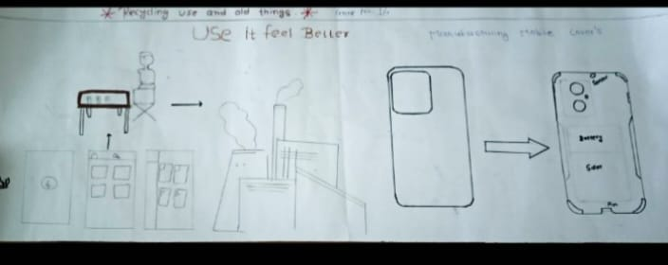
FEATURES OF THE TOPIC
MARS
JUPITER
VENUS
Despite being red, Mars is actually a cold place. It’s full of iron oxide dust, giving the planet its reddish cast
It’s a gas giant and the biggest planet in our Solar System. Jupiter is the fourth-brightest object in the sky
Venus has a beautiful name and is the second planet from the Sun. It’s terribly hot, even hotter than Mercury

Slide 12
The mind map highlights the importance of recycling used and old things, focusing on various materials, environmental impact, future trends, goals, participation, innovations, degradation, and channels.

Slide 13
5W1H JUSTIFICATION

Slide 14
project aims to promote recycling of used and old things, focusing on various materials, environmental impact, future trends, goals, participation, innovations, degradation, and channels.
MAIN KEY QUESTION
Q:Who is affected by the problem of not recycling used and old things?
A: The environment, individuals, communities, and future generations are affected by the problem of not recycling used and old things.
Q: What is the issue with not recycling used and old things?
A: The issue is the waste and pollution caused by not recycling, which harms the environment and depletes natural resources.
Q: Where does the problem of not recycling used and old things occur?
A: The problem occurs globally, in various communities, and in individual households.

Slide 15
Q: When does the problem of not recycling used and old things occur?
A: The problem occurs daily, as people discard used and old things without recycling them.
Q: Why is it important to recycle used and old things?
A: Recycling used and old things is important because it reduces waste, conserves resources, saves energy, and ultimately contributing to a more sustainable environment.
Q: How can we promote recycling of used and old things?
A: because we are using using recycling used and and create our product will be phone cover and any new product

Slide 16
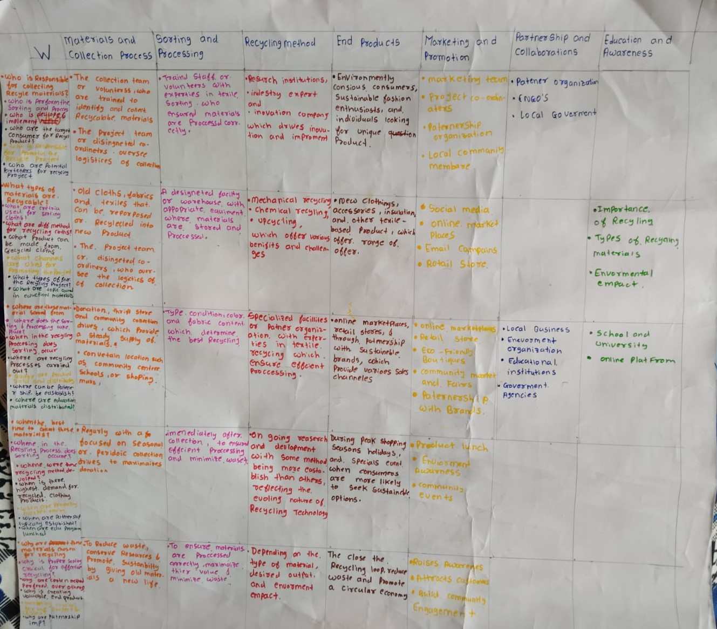

Slide 17
THANKS!
Please keep this slide for attribution.

